Slide 1

Team Name : Space Gladiators
Team Leader Name : Shendre Samarth Manish
Problem Statement : AI-based Help Bot for Information Retrieval from a Knowledge Graph Based on Static/Dynamic Web Portal Content

Slide 2

Team Members
Team Leader: Name: Shendre Samarth Manish College: Sinhgad College Of Engineering,Pune | Team Member-1: Name: Shivam Goraksha Dahifale College: Sinhgad College Of Engineering,Pune
Team Member-2: Name: Saee Bandal College: Sinhgad College Of Engineering,Pune | Team Member-3: Name: Shreya Balakrishna Ghodake College: Sinhgad College Of Engineering,Pune

Slide 3
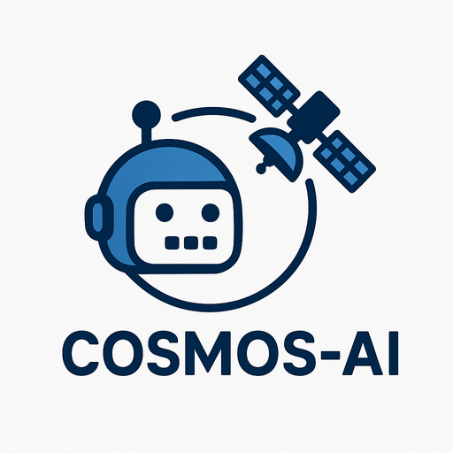
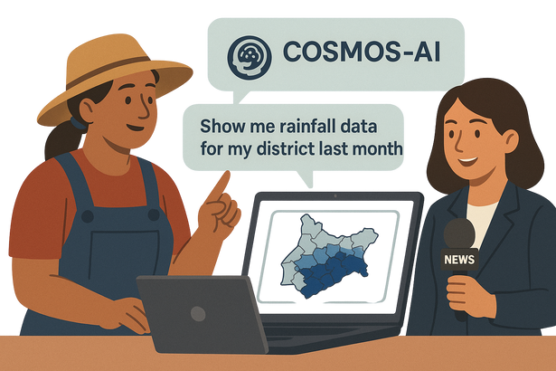
Brief about the Idea:
COSMOS-AI:
Cognitive Observatory for Space & Meteorological Operations Support
COSMOS-AI is an intelligent virtual assistant that transforms how users interact with ISRO's MOSDAC portal by converting complex satellite data and documentation into conversational experiences.
Releveance
Farmer : Show me rainfall data for my district last month" - gets instant maps instead of navigating 15+ menu layers
News Report :Need latest satellite images of flooding in Assam" - instant access during breaking news coverage
📋 Overview:
Intelligent Data Navigator for MOSDAC content
Hybrid AI Architecture (Knowledge Graph + RAG)
Multi-Modal Intelligence processing
Geospatial Query Engine with location-time capabilities

Slide 4
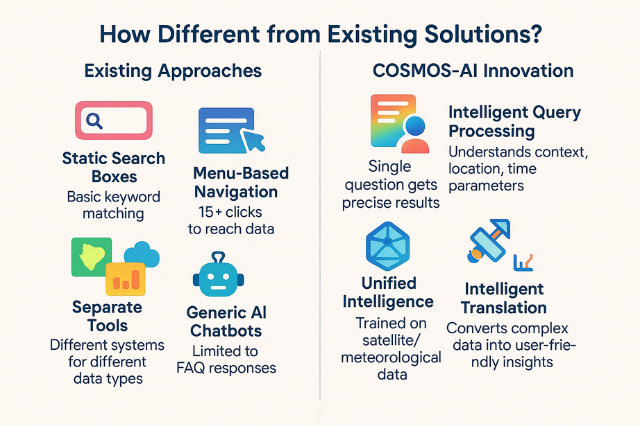

Opportunity should be able to explain the following:
🎯 How It Solves the Problem
MOSDAC contains 10+ years of satellite data across 50+ categories, but users spend 20-30 minutes finding specific information due to complex navigation and technical barriers.
Intelligent Data Discovery: Proactive suggestions based on query patterns
Context-Aware Processing: Intelligent clarification system for ambiguous queries
Real-Time Data Integration: Live satellite feed integration with historical data
Multi-Stakeholder Accessibility: Adaptive response formatting based on user profile
⭐ Unique Selling Propositions (USP)
Hybrid AI Engine
Geo-Temporal Query Support
Conversational Data Access
Multi-Format Intelligence
Adaptive Responses by User Type
Real-Time Satellite Alerts
Proactive Query Clarification
Multilingual Support
Combines Knowledge Graph + RAG for accurate and contextual responses.
Understands location + time queries like "rainfall in Assam last month".
Turns complex data into simple chat — no need for 15+ menu clicks.
Reads PDFs, DOCX, XLSX, ARIA-tagged HTML in one unified system.
Integrates live feeds for disasters like floods, fires, cyclones.
Works in English and Hindi to reach both experts and rural users.
Scientist, farmer, or journalist — gets info in their preferred format.
Smart follow-ups for vague questions — boosts user experience.

Slide 5











List of features offered by the solution
Natural Language Query Support
Users can ask questions like “satellite images for Kerala flood” in plain English or Hindi.
Multilingual Support (EN + HI)
Allows users from diverse backgrounds to interact effortlessly.
User-Adaptive Responses
Customizes answers depending on whether the user is a farmer, scientist, or journalist.
Hybrid AI Processing
Uses both Knowledge Graph and Retrieval-Augmented Generation (RAG) for smart, contextual answers.
Live Satellite Feed Integration
Pulls in real-time data and overlays it with historical maps for dynamic insights.
Multi-format Data Ingestion
Crawls and understands data from PDFs, DOCX, XLSX, FAQs, and ARIA-tagged web content.
Geo-Temporal Query Engine
Understands queries based on location + time (e.g., “rainfall in Gujarat last August”).
Conversational UI Chatbot
Smart, multi-turn conversations with context memory and follow-up clarification.

Slide 6
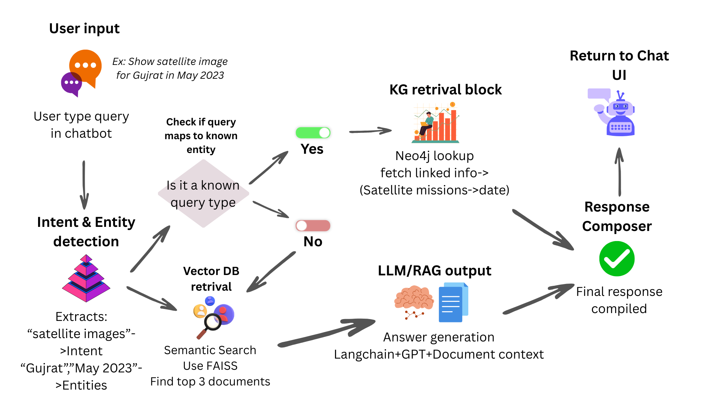
Process flow diagram

Slide 7
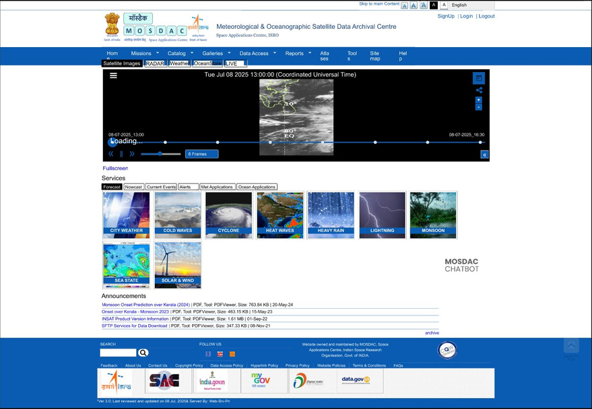
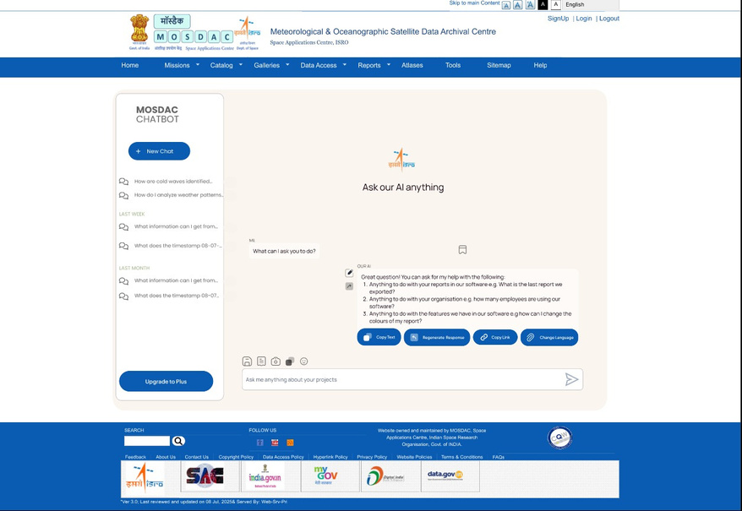

Wireframes/Mock diagrams of the proposed solution (optional)
Chatbot Option at MOSDAC Portal
Overview of Chatbot

Slide 8
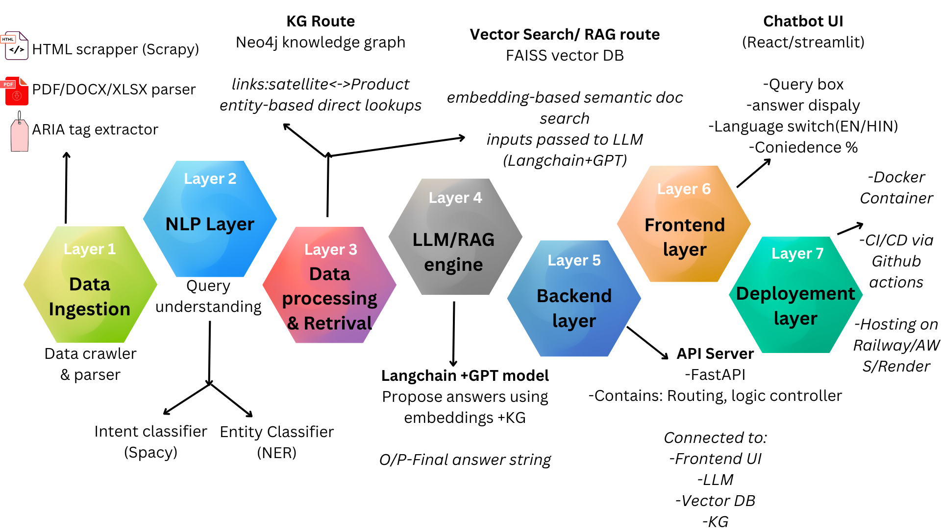
Architecture diagram of the proposed solution

Slide 9

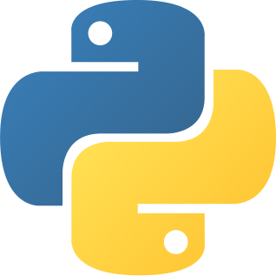













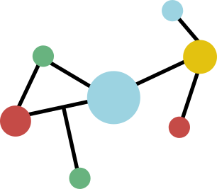

Technologies to be used in the solution:
Core language for backend logic, crawling, NLP, and integration.
Python
FAISS (Vector Search Engine)
Enables fast semantic search across embedded documents.
To crawl static and dynamic content (HTML, metadata, tables) from MOSDAC.
Scrapy + BeautifulSoup
LangChain + OpenAI/GPT
For Retrieval-Augmented Generation (RAG) — combines context with generative AI.
Parsing and extracting content from PDFs, DOCX, XLSX files.
PyMuPDF, python-docx, openpyxl
Streamlit / React.js
Frontend chatbot interface (choose one based on your speed/UX needs).
For Named Entity Recognition (NER), intent detection, and tokenization.
spaCy + NLTK
Lightweight backend server to handle API requests and integrate modules.
FastAPI
To model entities like satellites, missions, and products with their relationships.
Neo4j (Knowledge Graph)
Docker + GitHub Actions
Containerization and automated CI/CD for scalable, modular deployment.

Slide 10
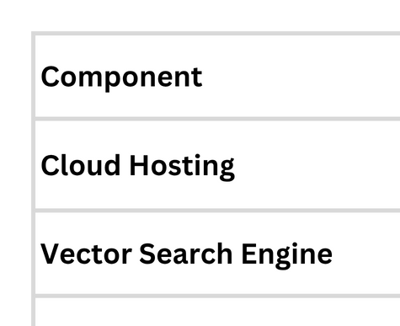
Estimated implementation cost:
Total Estimated Cost (For MVP – 3 Months): ₹15,000 – ₹20,000

Slide 11
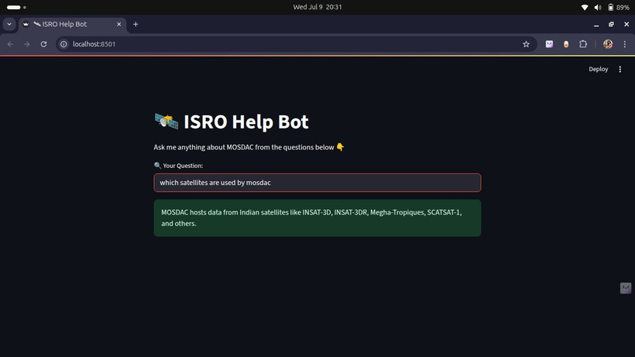
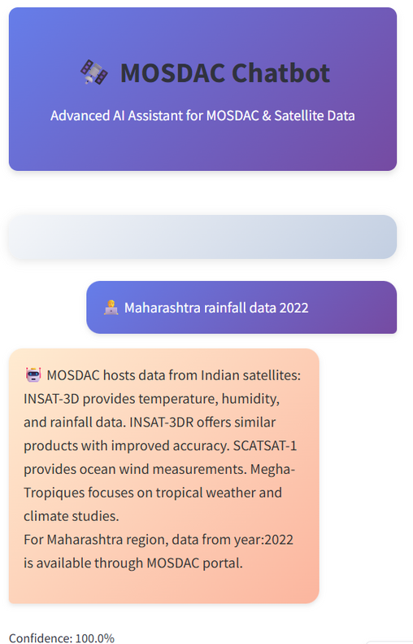
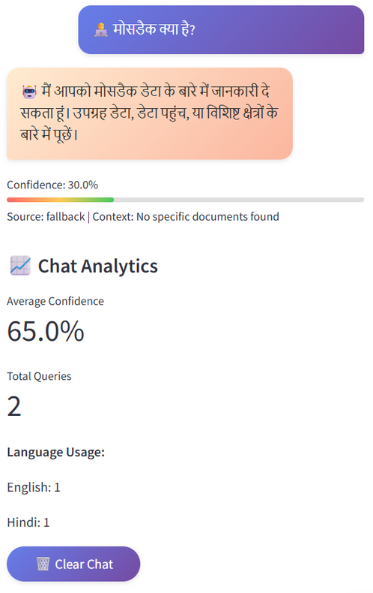
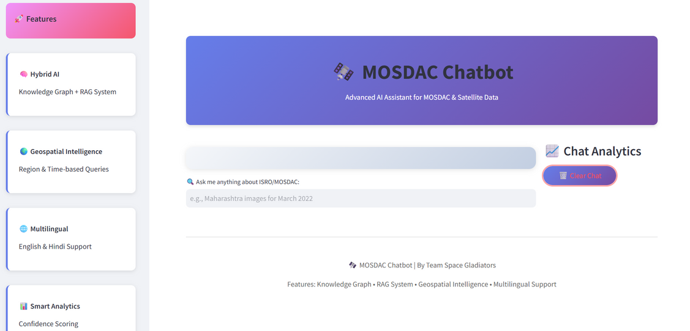
Prototype Screenshots:
Prototype 1 - MOSDAC Chatbot
Prototype 2 - MOSDAC Chatbot - Mobile Version (For Simple User Farmers)
Prototype 2 - MOSDAC Chatbot - Desktop Version (For Researchers)

Slide 12
